Slide 1
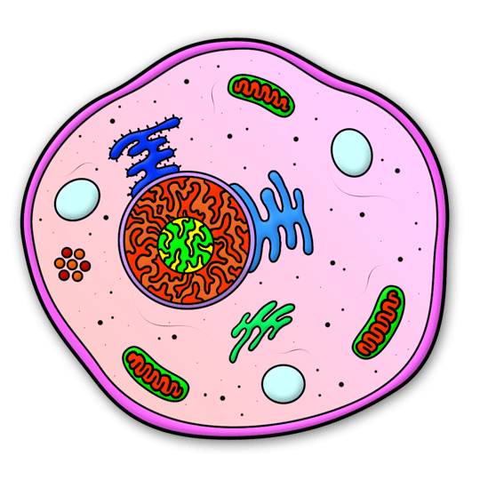


Foundations of Entrepreneurship
April 30, 2014
Jasmin Chen
Maryelise Cieslewicz
Alex Jiao
Abhigyan Kaustubh
Greg Uratsu

Slide 2
Problem
571,000 Current
700,000 2015 Estimate
End Stage Renal Disease
Kidney Transplant
3-5 years
$17,000/year
Immunosuppressive Drugs for Kidney Transplant
$70,000/year
Dialysis

Slide 3
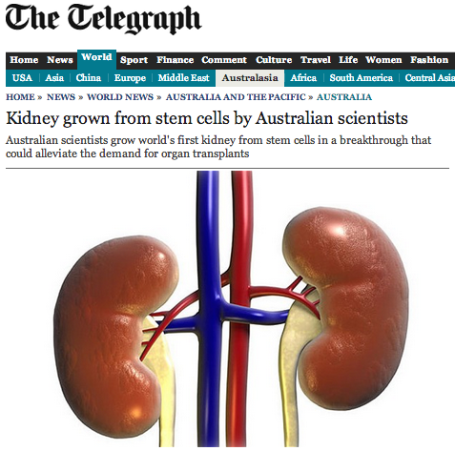
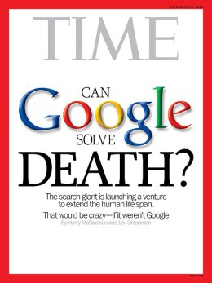
Induced Pluripotent Stem Cells Can
Be Used to Regenerate Your Organs

Slide 4
Solution
First public iPS cell bank
Allows consumers to store their stem cells
Non-invasive cell collection
Reduce organ wait time
No immune rejection
INSURANCE FOR YOUR ORGANS!

Slide 5
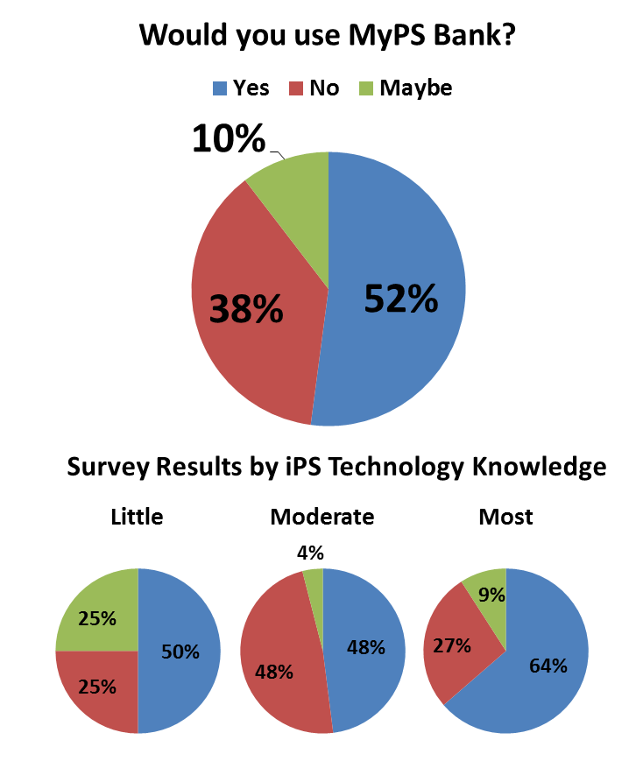
Lessons Learned – Customer Survey
Most and least knowledgeable individuals are likely to use myPS Bank
Most individuals would require consultation with a doctor to use myPS Bank

Slide 6



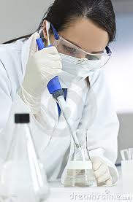
Customer Acquisition
New Parents
Healthy, Retired Couples
General Public
Disseminate information about myPS Bank
through primary care doctors and specialists
Research Institutions
Pilot use of cell samples a select local institutions
Use valuable customer feedback to improve system and gain credibility

Slide 7


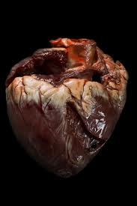
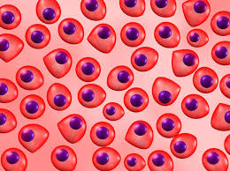
Revenue Model
Sell Unused Cells to Research Institutions
Yearly Fee for Continued Storage of the Cells
Initial
One-Time
Fee to Generate
iPS Cells
Cells Are
Used to Generate
an Organ
[NO REVENUE]
Notes:
Should we include grant money in revenue? That seems more like funding to me?

Slide 8
Milestones
Develop Cell Transformation and Storage Methods
FDA Compliance
Initial Customer Acquisition
Scale up User Base;
Exit Strategy
Quality Control
Cell Genetically Normal
Viable Storage
Viable Thaw
Establish FDA-approved protocols
Number of customers storing cells
Length of cell storage
Establishment of Clinics for cell sample collection
Increase in sales force
Number of conversions to organs
Phase I SBIR Grant
DoD Grant
Incubators
Phase II SBIR
Venture Funding
$500,000
$2 Million
$15 Million

Slide 9
Questions?

